Slide 1
Chapter 2 Introduction to Java Applications; Input/Output and Operators
Java How to Program, 11/e
Questions? E-mail paul.deitel@deitel.com

Slide 2
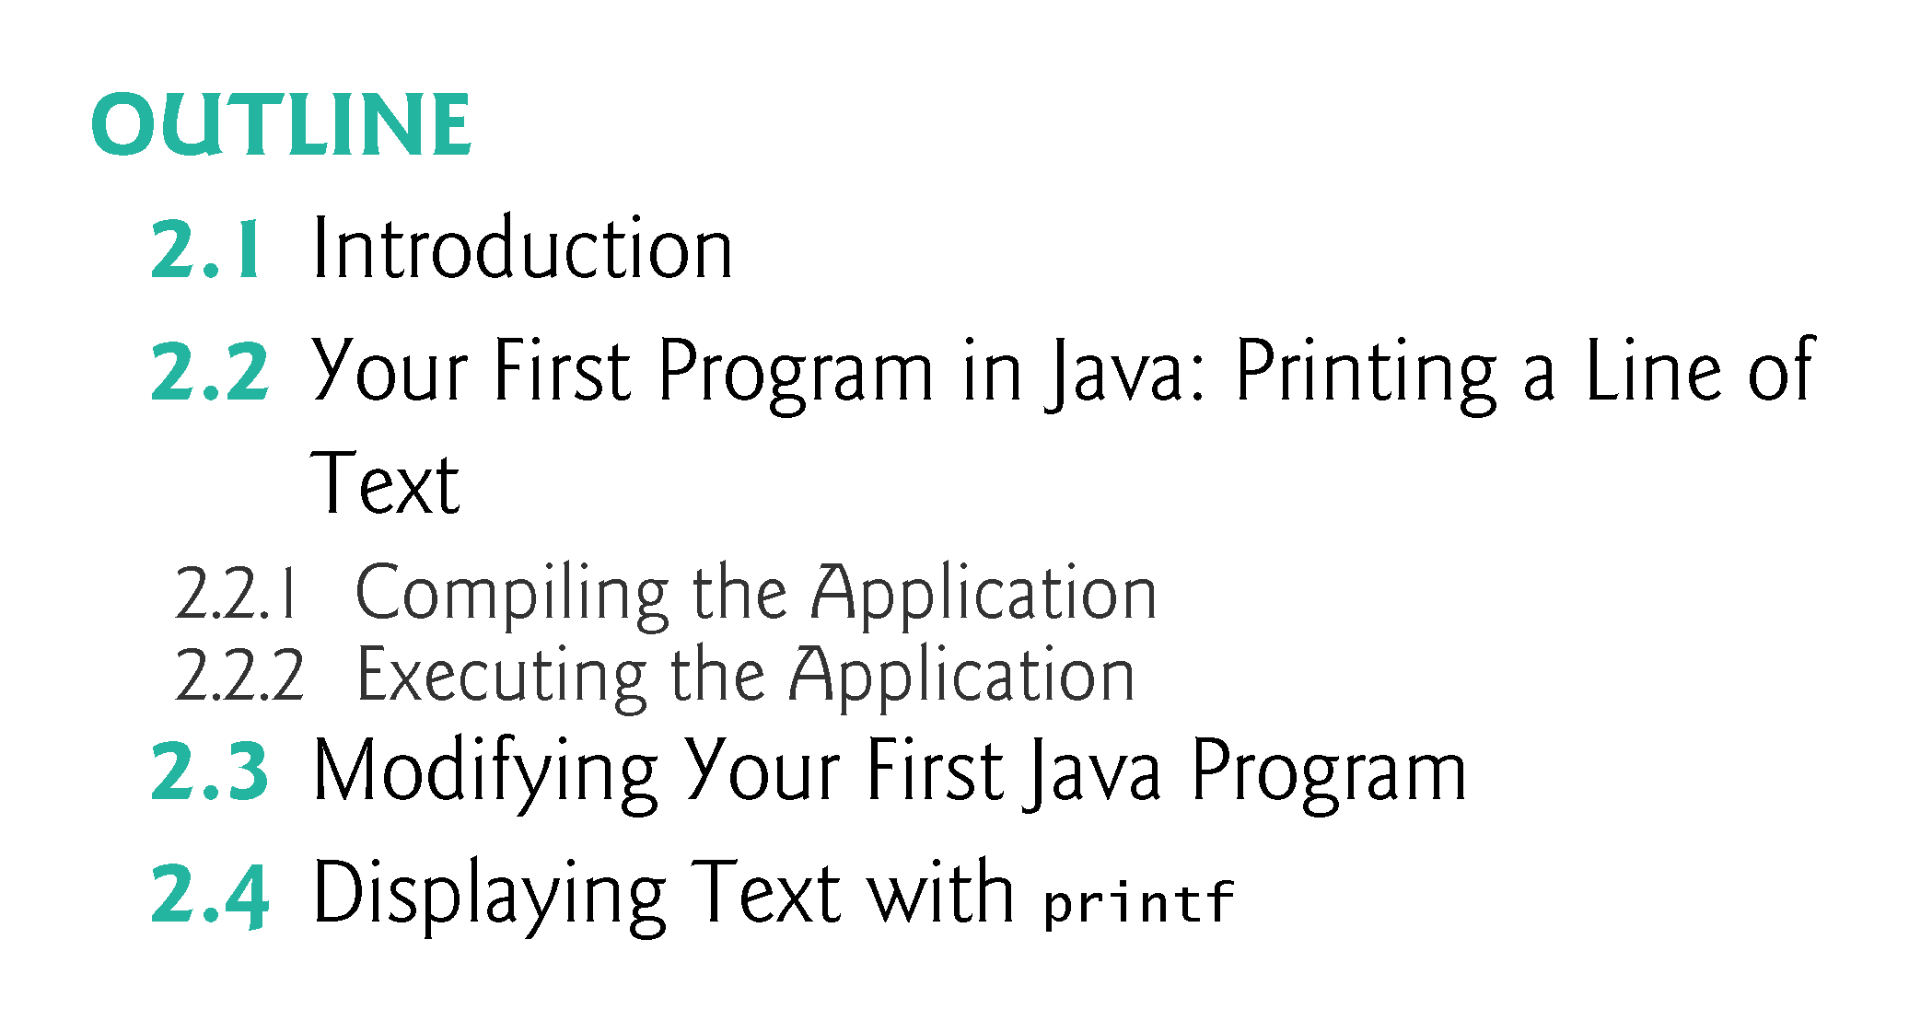

Slide 3
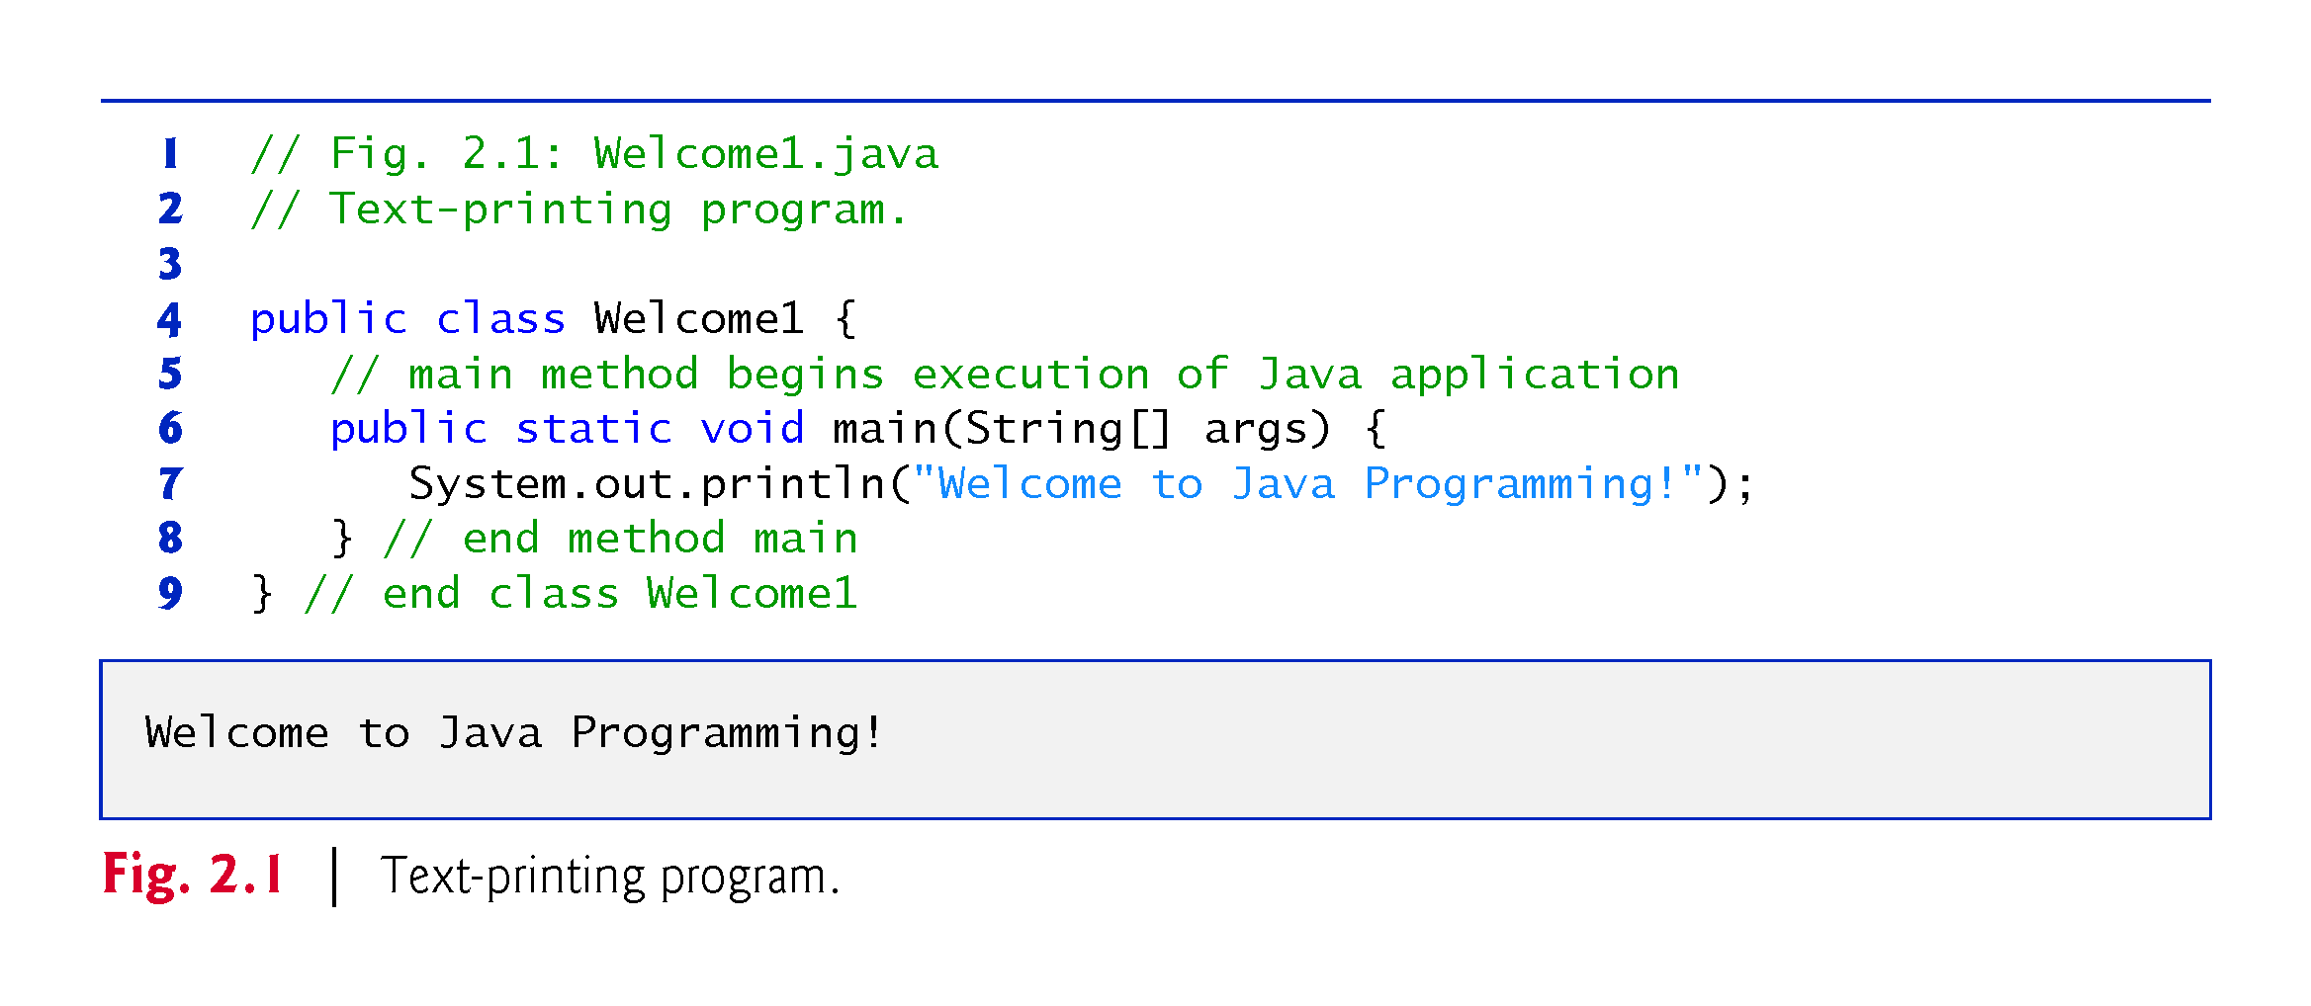

Slide 4
2.2 Your First Program in Java: Printing a Line of Text (Cont.)
Commenting Your Programs
Comments
// Fig. 2.1: Welcome1.java
// indicates that the line is a comment.
Used to document programs and improve their readability.
Compiler ignores comments.
A comment that begins with // is an end-of-line comment—it terminates at the end of the line on which it appears.
Traditional comment, can be spread over several lines as in
/* This is a traditional comment. It can be split over multiple lines */
This type of comment begins with /* and ends with */.
All text between the delimiters is ignored by the compiler.

Slide 5
2.2 Our First Program in Java: Printing a Line of Text (Cont.)
Javadoc comments
Delimited by /** and */.
All text between the Javadoc comment delimiters is ignored by the compiler.
Enable you to embed program documentation directly in your programs.
The javadoc utility program (online Appendix G) reads Javadoc comments and uses them to prepare program documentation in HTML5 format.

Slide 6
2.2 Your First Program in Java: Printing a Line of Text (Cont.)
Declaring a class
Class declaration
public class Welcome1
Every Java program consists of at least one class that you define.
class keyword introduces a class declaration and is immediately followed by the class name.
Keywords (Appendix C) are reserved for use by Java and are always spelled with all lowercase letters.

Slide 7
2.2 Your First Program in Java: Printing a Line of Text (Cont.)
Filename for a public Class
A public class must be placed in a file that has a filename of the form ClassName.java, so class Welcome1 is stored in the file Welcome1.java.
Class Body
A left brace, {, begins the body of every class declaration.
A corresponding right brace, }, must end each class declaration.

Slide 8
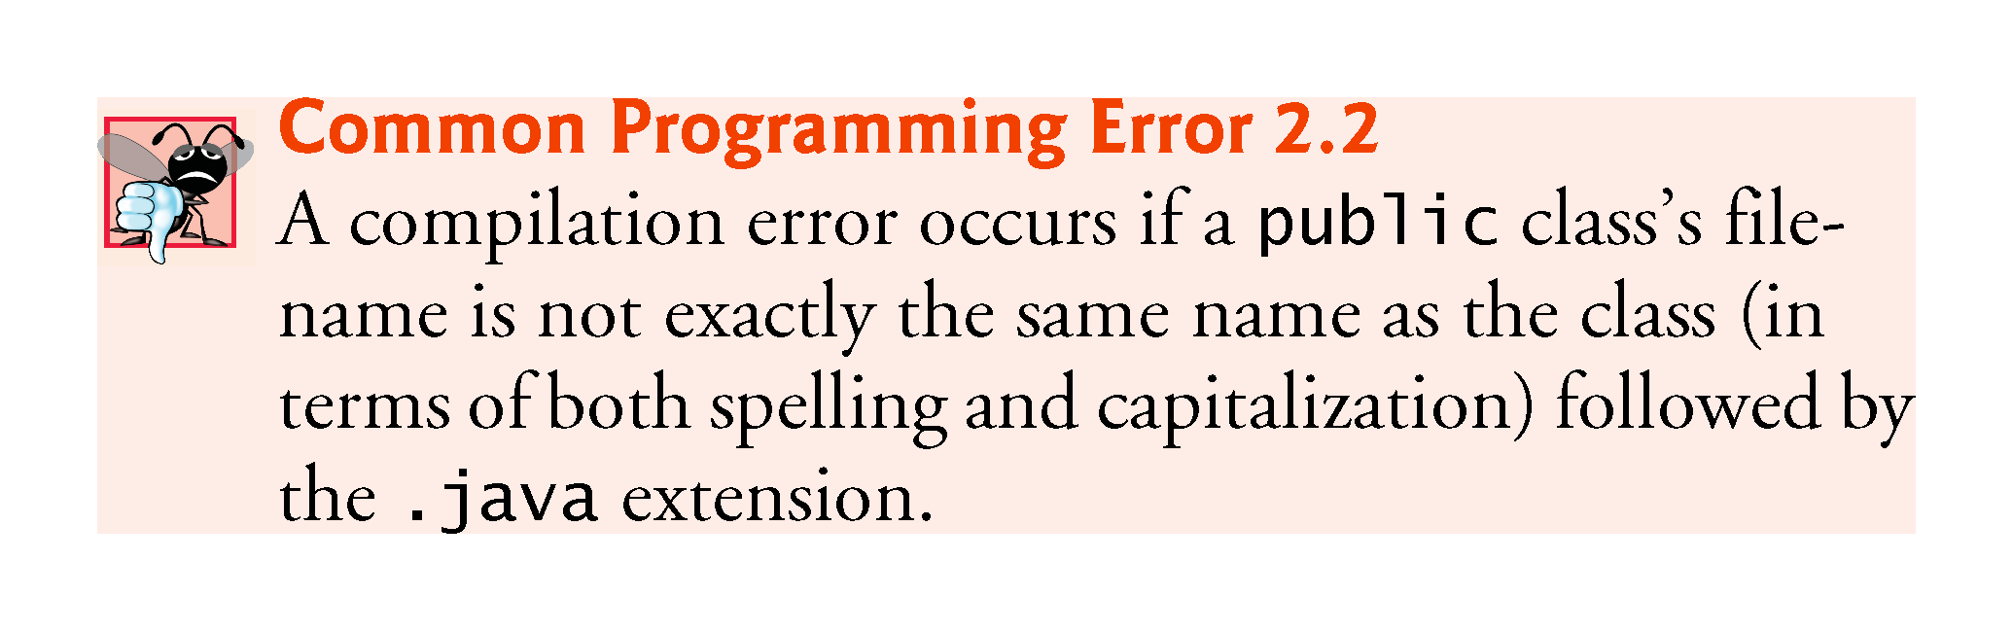

Slide 9
2.2 Your First Program in Java: Printing a Line of Text (Cont.)
Class Names and Identifiers
By convention, begin with a capital letter and capitalize the first letter of each word they include (e.g., SampleClassName).
A class name is an identifier—a series of characters consisting of letters, digits, underscores (_) and dollar signs ($) that does not begin with a digit and does not contain spaces.
Java is case sensitive—uppercase and lowercase letters are distinct—so a1 and A1 are different (but both valid) identifiers.
Underscore (_) in Java 9
As of Java 9, you can no longer use an underscore (_) by itself as an identifier.

Slide 10
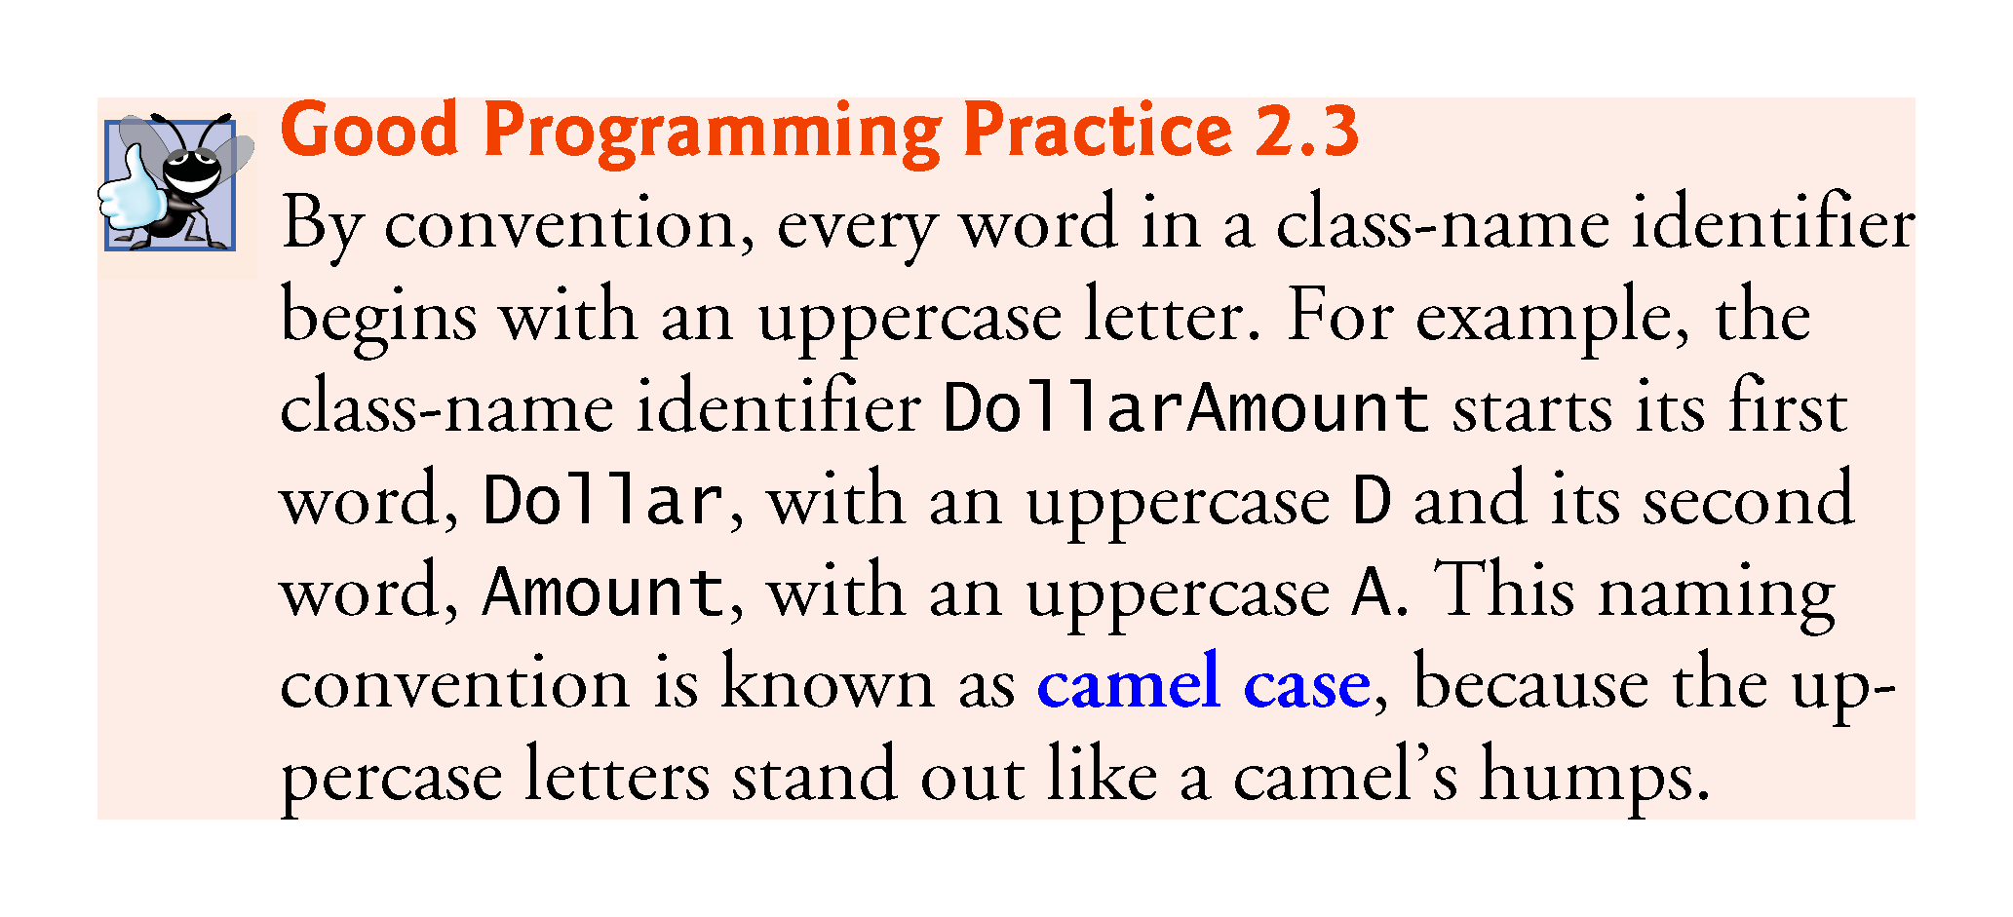

Slide 11
2.2 Your First Program in Java: Printing a Line of Text (Cont.)
Declaring a Method
public static void main(String[] args) {
Starting point of every Java application.
Parentheses after the identifier main indicate that it’s a program building block called a method.
Java class declarations normally contain one or more methods.
main must be defined as shown; otherwise, the JVM will not execute the application.
Methods perform tasks and can return information when they complete their tasks.
Keyword void indicates that this method will not return any information.

Slide 12
2.2 Your First Program in Java: Printing a Line of Text (Cont.)
Statement
System.out.println("Welcome to Java Programming!");
Together, the quotation marks and the characters between them are a string—also known as a character string or a string literal.
Strings cannot span multiple lines of code.

Slide 13
2.2 Your First Program in Java: Printing a Line of Text (Cont.)
System.out object
Standard output object.
Allows a Java application to display information in the command window from which it executes.
System.out.println method
Displays (or prints) a line of text in the command window.
The string in the parentheses the argument to the method.
Positions the output cursor at the beginning of the next line in the command window.
Most statements end with a semicolon.

Slide 14
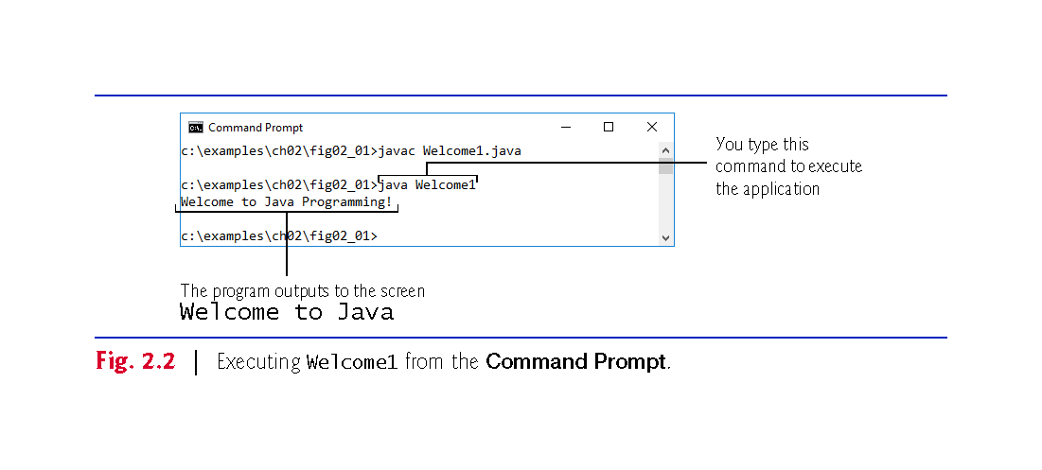

Slide 15
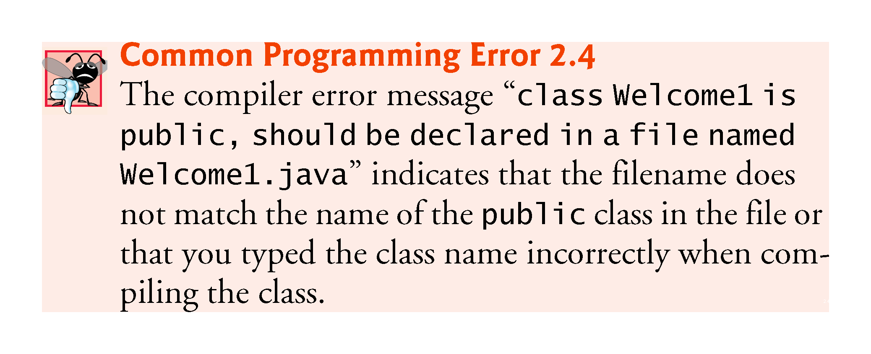

Slide 16
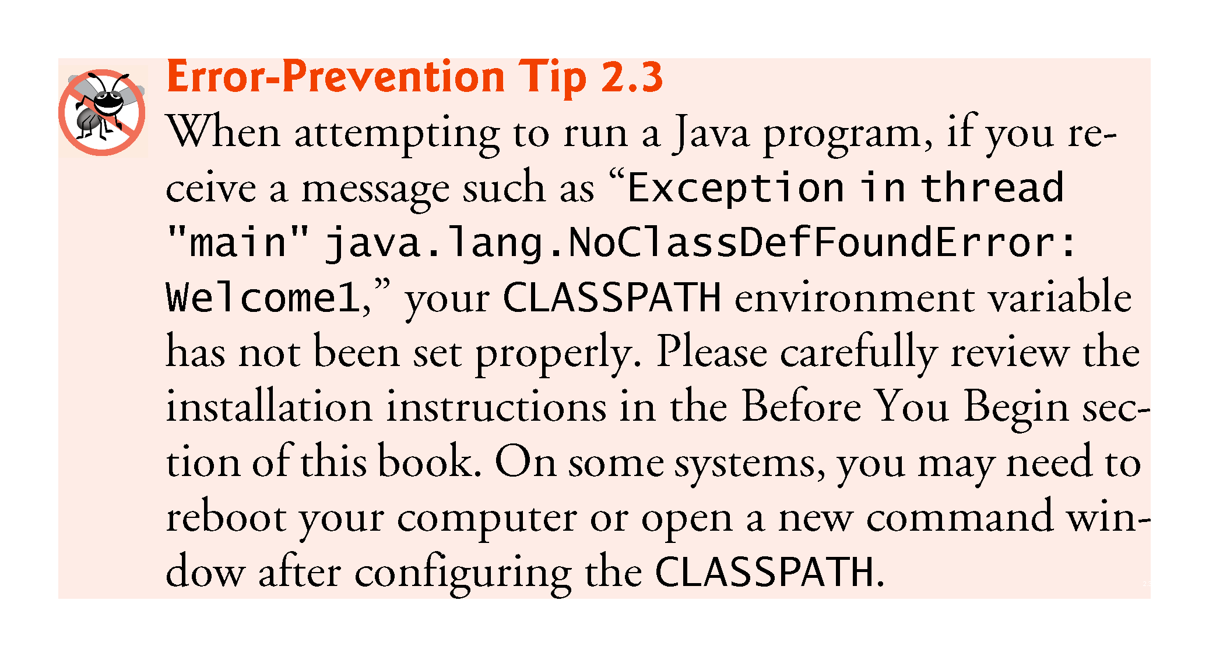

Slide 17
2.3 Modifying Your First Java Program
Class Welcome2, shown in Fig. 2.3, uses two statements to produce the same output as that shown in Fig. 2.1.
New and key features in each code listing are highlighted.
System.out’s method print displays a string.
Unlike println, print does not position the output cursor at the beginning of the next line in the command window.
The next character the program displays will appear immediately after the last character that print displays.

Slide 18
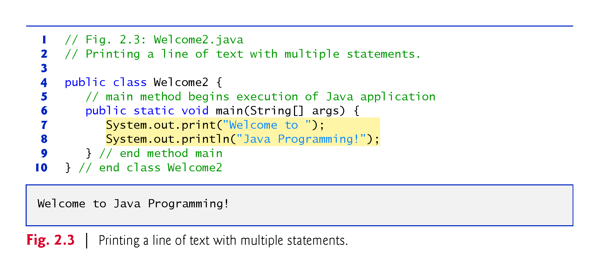

Slide 19
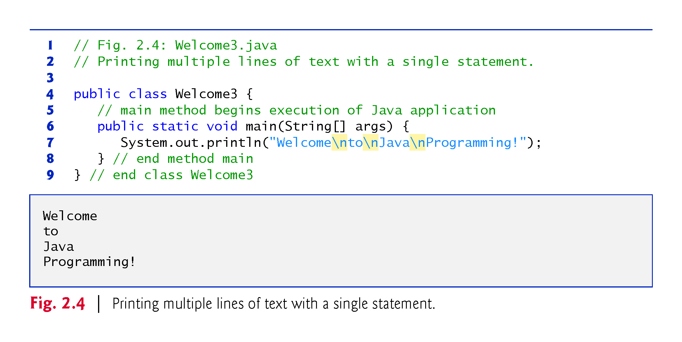

Slide 20
2.3 Modifying Your First Java Program (Cont.)
Newline characters indicate to System.out’s print and println methods when to position the output cursor at the beginning of the next line in the command window.
Newline characters are whitespace characters.
The backslash (\) is called an escape character.
Indicates a “special character”
Backslash is combined with the next character to form an escape sequence—\n represents the newline character.

Slide 21
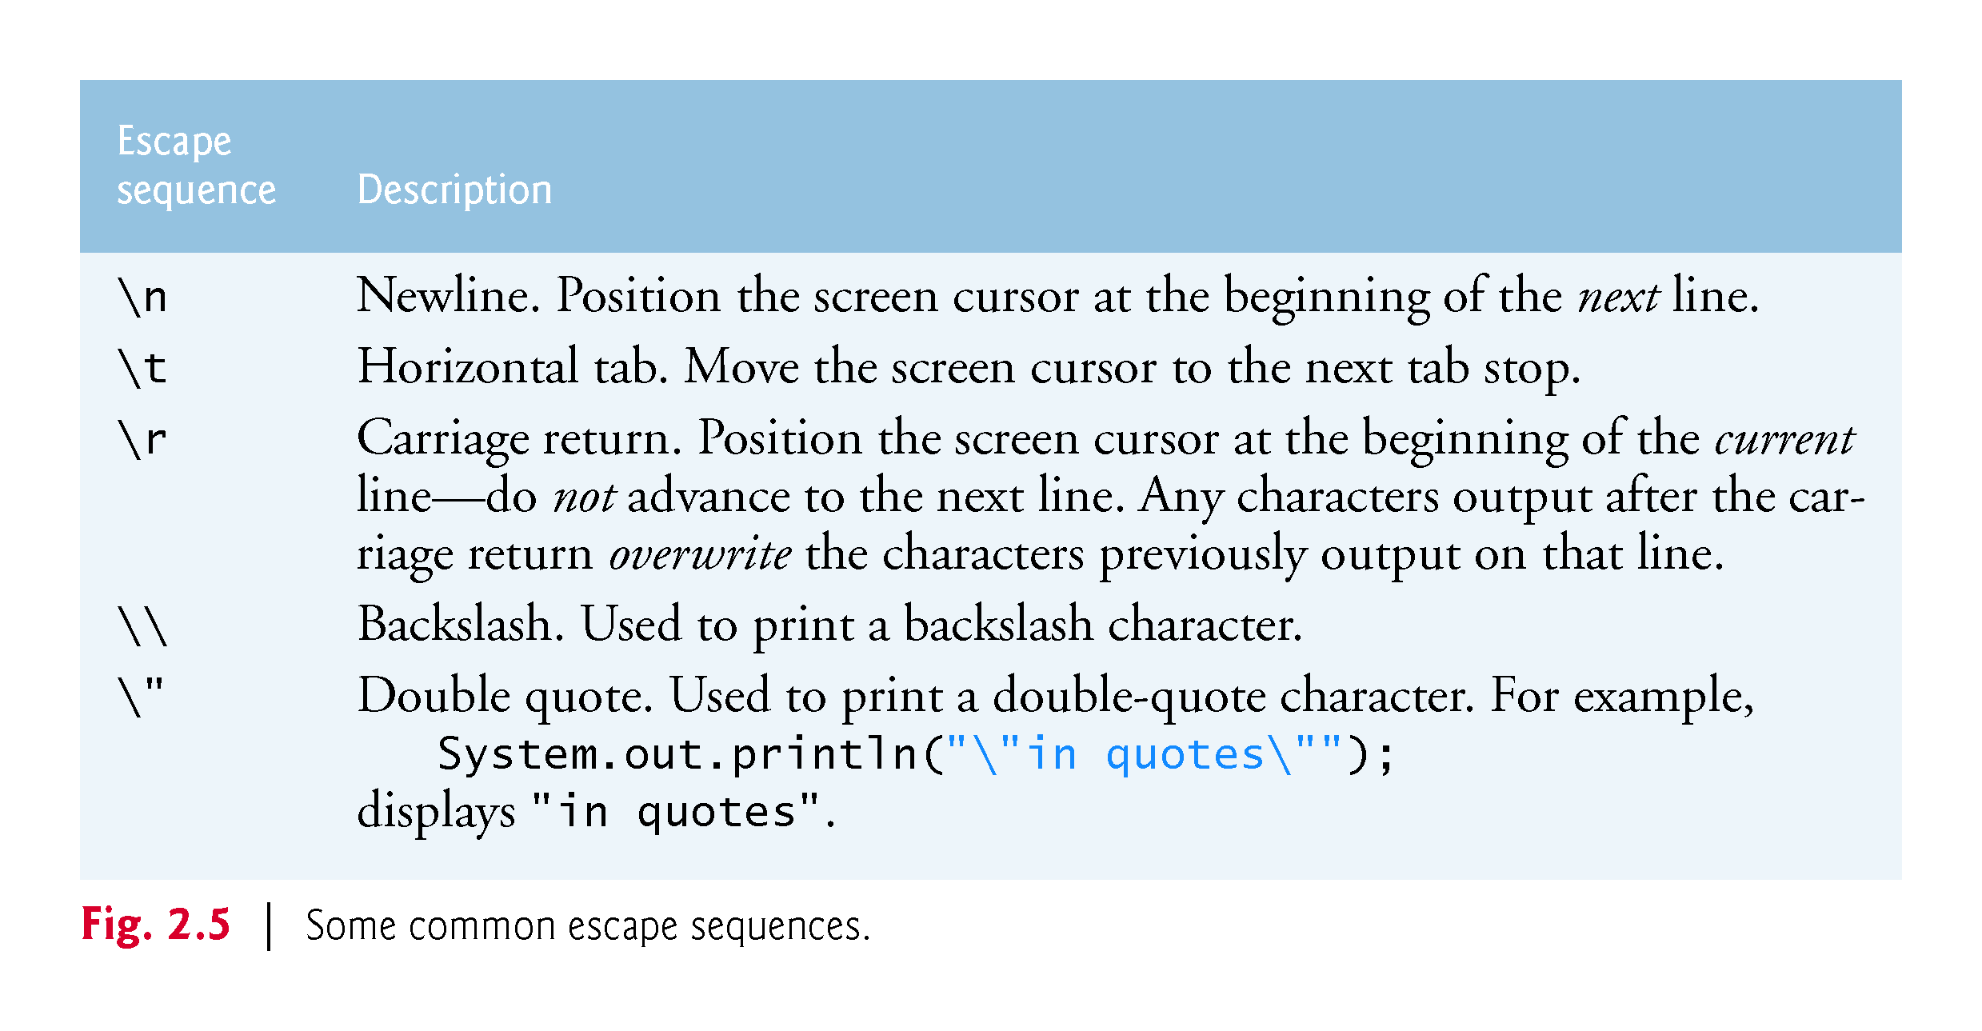

Slide 22
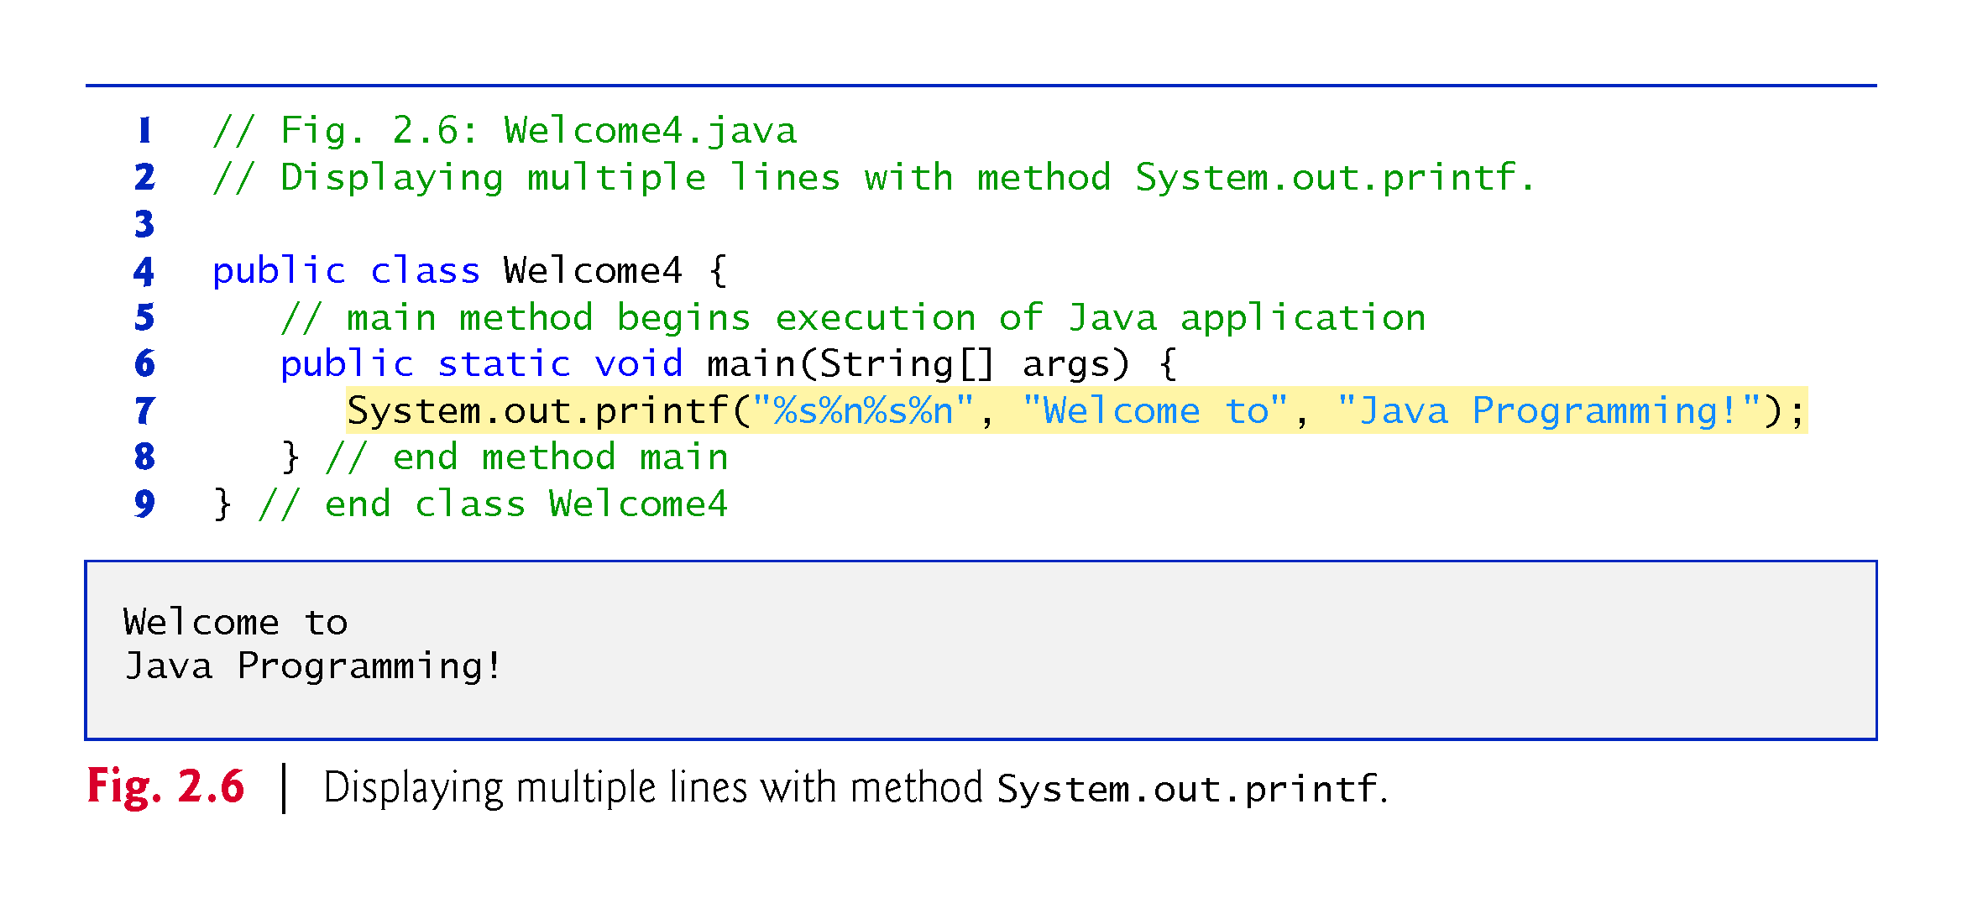

Slide 23
2.4 Displaying Text with printf
System.out.printf method
f means “formatted”
displays formatted data
Multiple method arguments are placed in a comma-separated list.
Method printf’s first argument is a format string
May consist of fixed text and format specifiers.
Fixed text is output as it would be by print or println.
Each format specifier is a placeholder for a value and specifies the type of data to output.
Format specifiers begin with a percent sign (%) and are followed by a character that represents the data type.
Format specifier %s is a placeholder for a string.

Slide 24
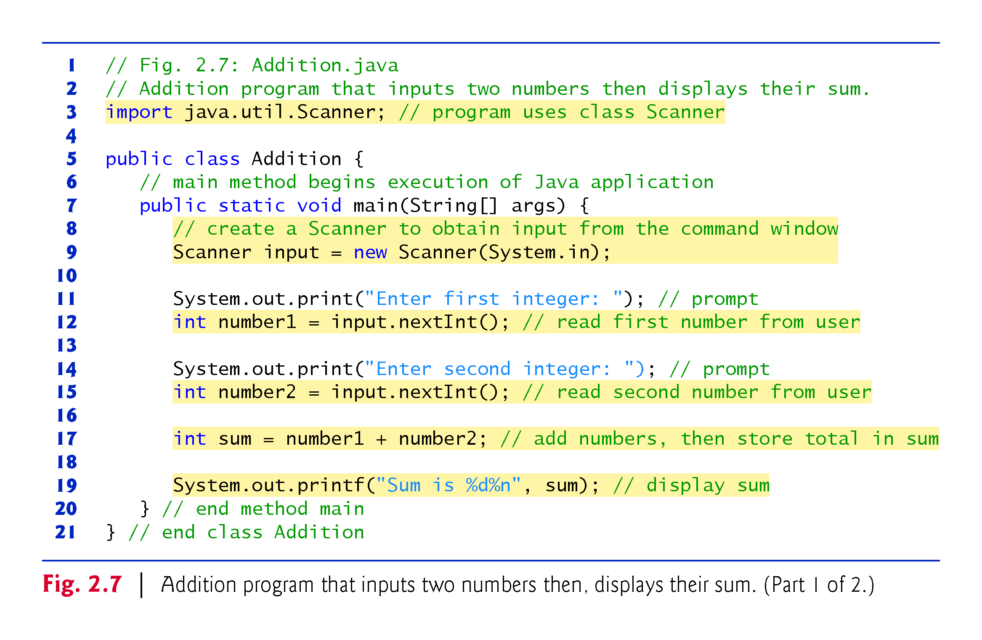

Slide 25
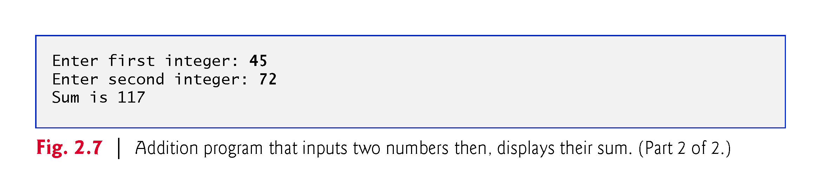

Slide 26
2.5 Another Application: Adding Integers (cont.)
import helps the compiler locate a class that is used in this program.
Rich set of predefined classes that you can reuse rather than “reinventing the wheel.”
Classes are grouped into packages—named groups of related classes—and are collectively referred to as the Java class library, or the Java Application Programming Interface (Java API).
You use import declarations to identify the predefined classes used in a Java program.

Slide 27
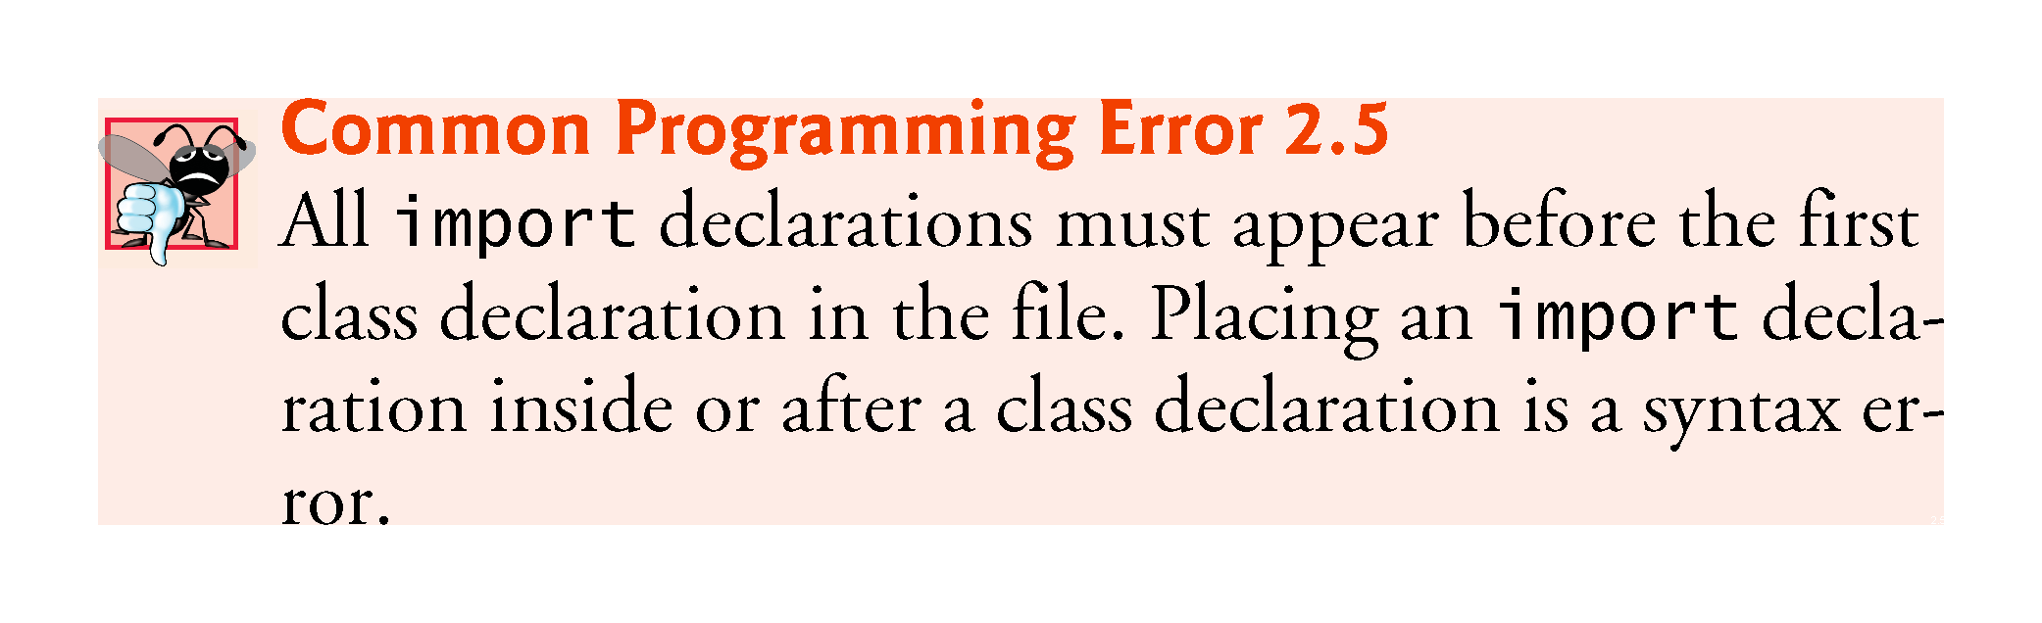

Slide 28
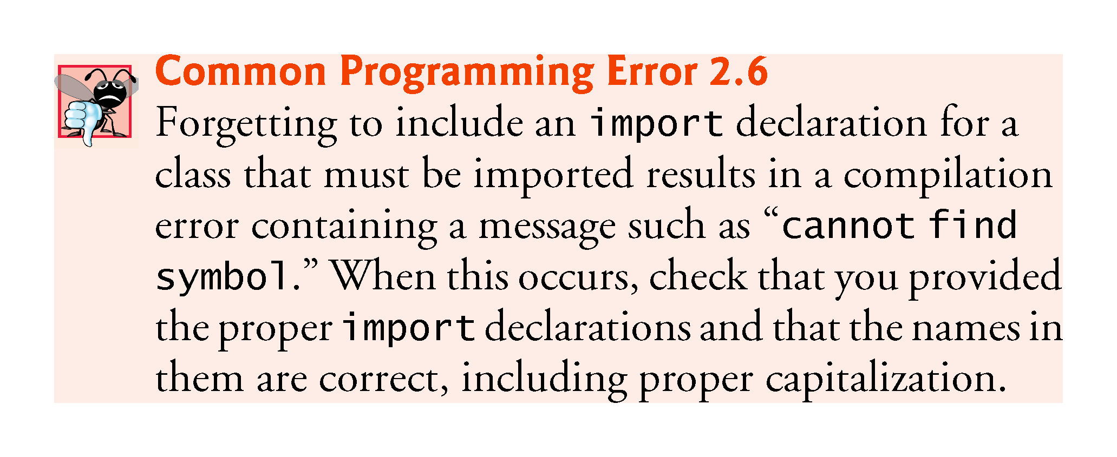

Slide 29
2.5 Another Application: Adding Integers (cont.)
Variable declaration statement
Scanner input = new Scanner(System.in);
Specifies the name (input) and type (Scanner) of a variable that is used in this program.
Variable
A location in the computer’s memory where a value can be stored for use later in a program.
Must be declared with a name and a type before they can be used.

Slide 30
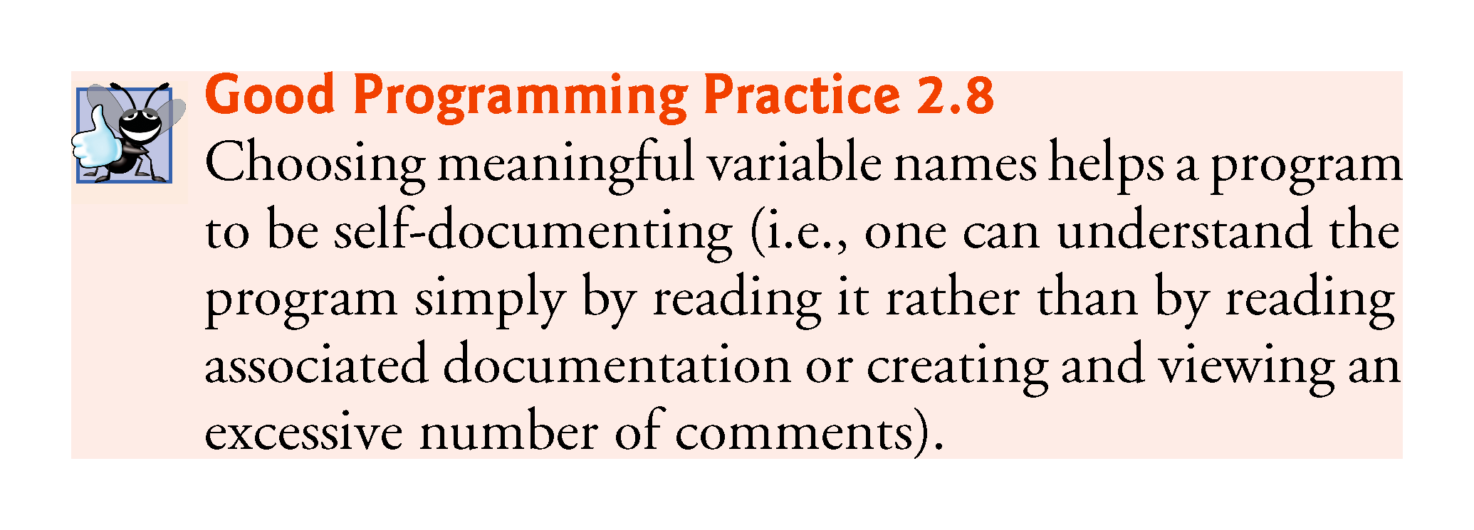

Slide 31
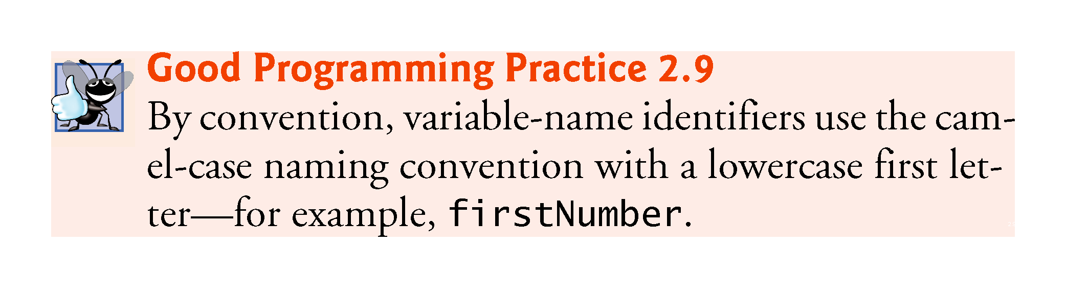

Slide 32
2.5 Another Application: Adding Integers (cont.)
Scanner
Enables a program to read data for use in a program.
Data can come from many sources, such as the user at the keyboard or a file on disk.
Before using a Scanner, you must create it and specify the source of the data.
The equals sign (=) in a declaration indicates that the variable should be initialized (i.e., prepared for use in the program) with the result of the expression to the right of the equals sign.
The new keyword creates an object.
Standard input object, System.in, enables applications to read bytes of data typed by the user.
Scanner object translates these bytes into types that can be used in a program.

Slide 33
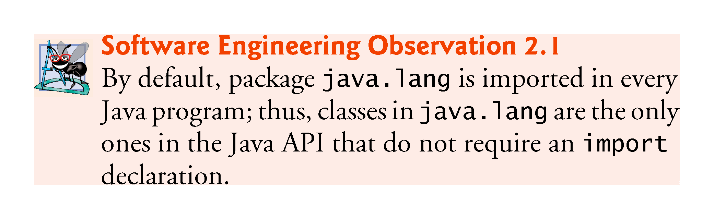
2.5.5 Prompting the User for Input
Class System
Part of package java.lang.
Class System is not imported with an import declaration at the beginning of the program.

Slide 34
2.5 Another Application: Adding Integers (cont.)
Scanner method nextInt
Obtains an integer from the user at the keyboard.
Program waits for the user to type the number and press the Enter key to submit the number to the program.
The result of the call to method nextInt is placed in variable number1
The = indicates that int variable number1 should be initialized in its declaration with the result of input.nextInt()
Integer formatted output
System.out.printf("Sum is %d%n", sum);
Format specifier %d is a placeholder for an int value
The letter d stands for “decimal integer.”

Slide 35
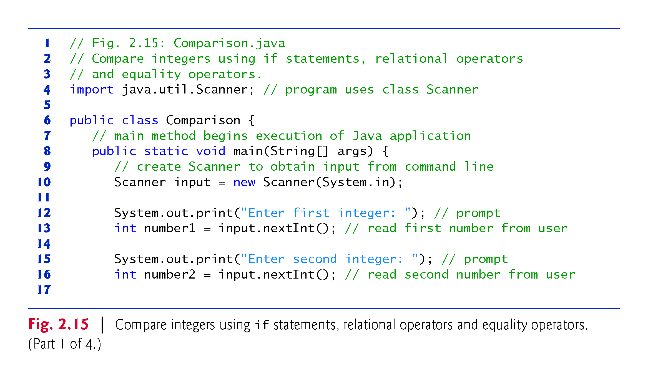

Slide 36
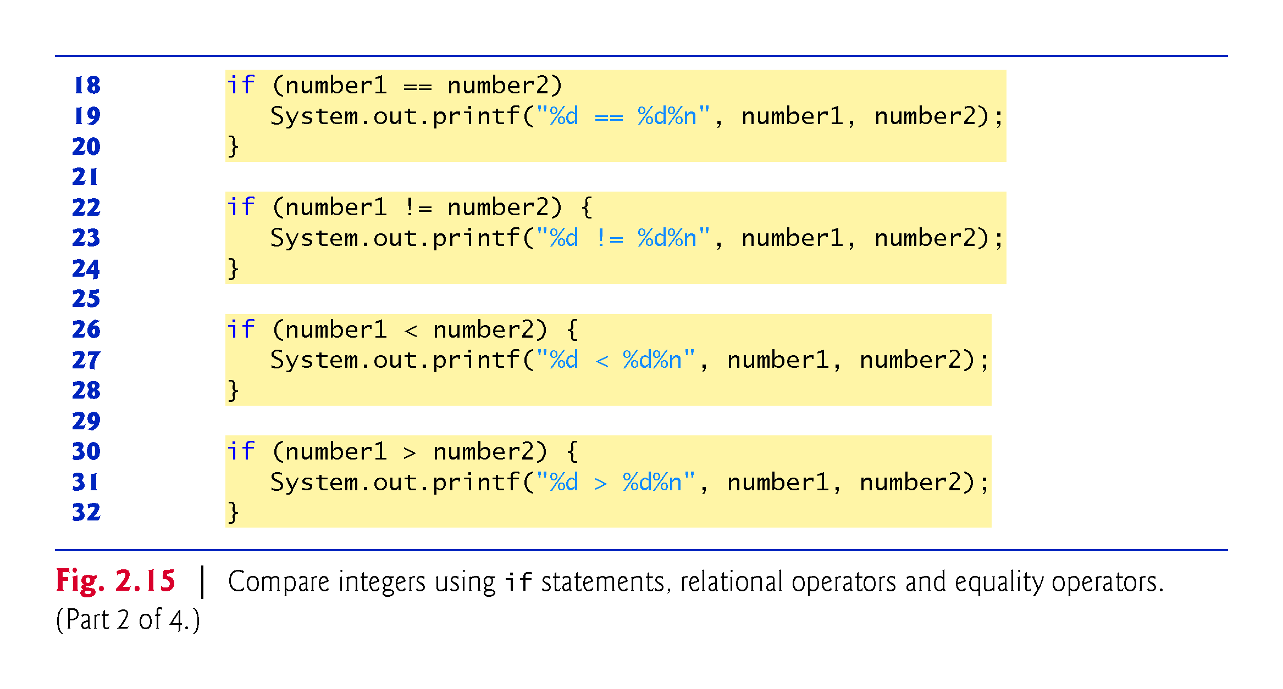

Slide 37
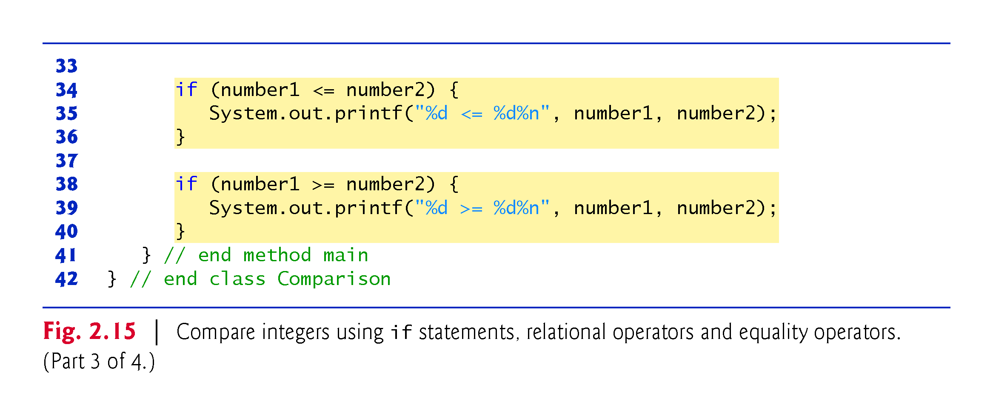

Slide 38
